Slide 1

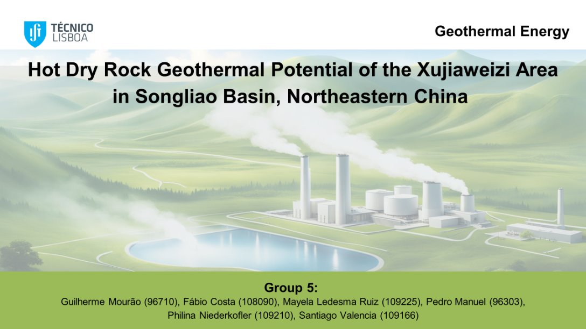
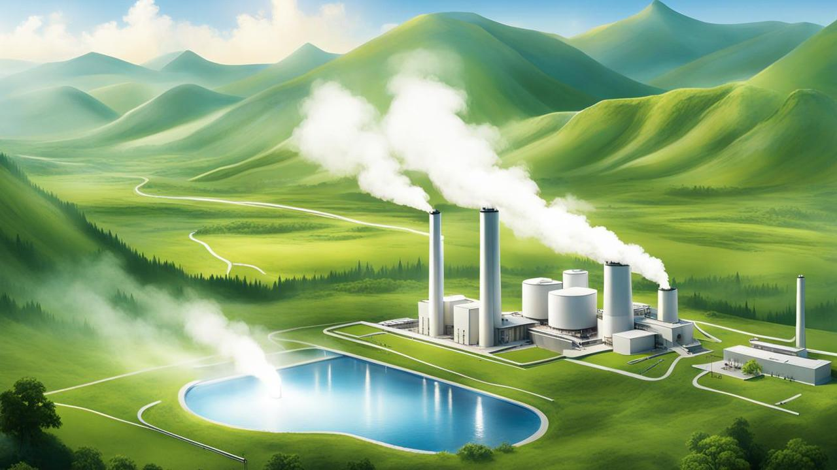
Geothermal Energy
Hot Dry Rock Geothermal Potential of the Xujiaweizi Area in Songliao Basin, Northeastern China
Group 5:
Guilherme Mourão (96710)
Fábio Costa (108090)
Mayela Ledesma Ruiz (109225)
Pedro Manuel (96303)
Philina Niederkofler (109210)
Santiago Valencia (109166)

Slide 2
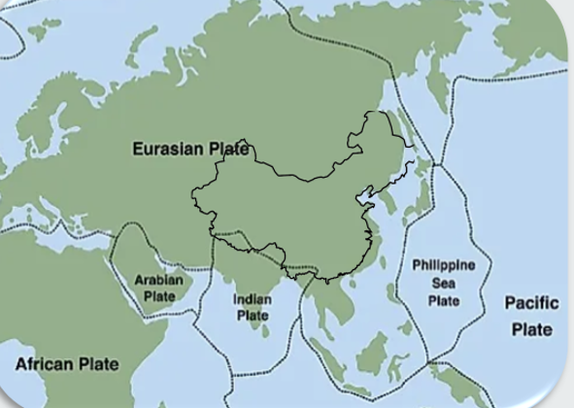






Recap
Available Data
Drilled area reduces­ drilling and transportation cost
(Guo et al., 2016)

Slide 3
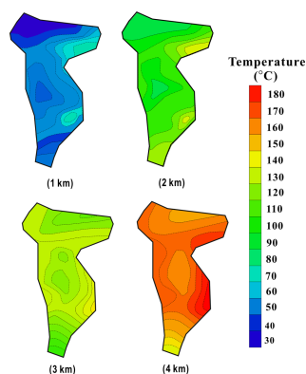
Recap
Depth [m] | Temperature Range [ºC ] | Average Temperature [ºC]
1000 | 39 – 60 | 48
2000 | 75 – 140 | 96
3000 | 108 – 136 | 121
4000 | 144 – 18 | 162
(Guo et al., 2016)

Slide 4
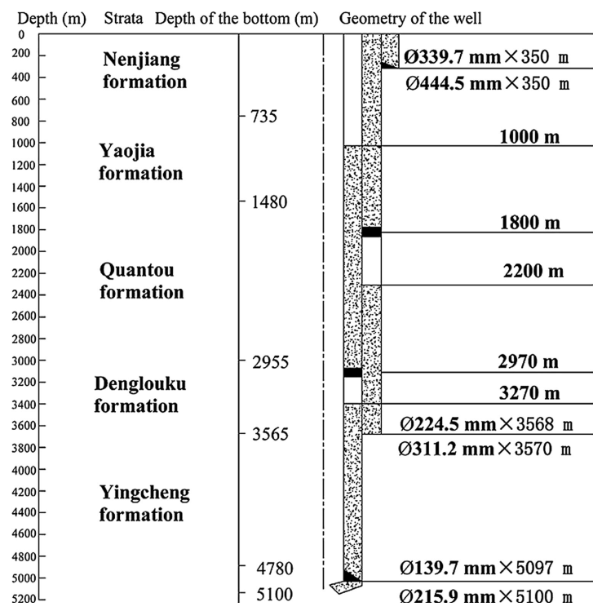
Target Well
Abandoned Oil Well
Parameters | Value
Rock Porosity | 1.2%-8.3%
Rock Permeability | 0.01-0.32 mD
Rock Density | 2440 kg/m^3
Rock Thermal Conductivity | 3.1 W/(mK)
4500 m as potential reservoir.
4800 m as target well.
(Guo et al., 2016)
Profile of the abandoned well YS-2
(Huang et al. 2014)

Slide 5
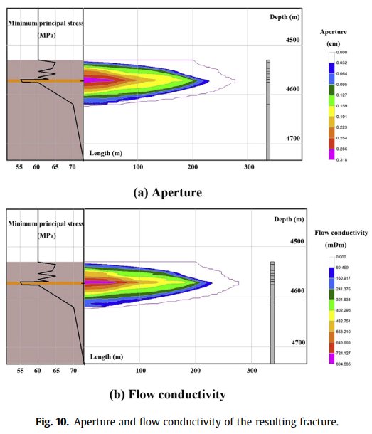
Reservoir Stimulation
Reservoir Characteristics
Half-length | 220m
Height | 80m
Fracture Parameters
Fracture Porosity | 1.2%-8.3%
Fracture Permeability | 0.01-0.32 mD
Fracture Density | 2440 kg/m^3
Spacing | 400m
Min recuriment for 3MW | 125 fractures
Fracture permeability | 675 D
Aperture and flow conductivity of the resulting fracture
(Guo et al., 2016)
(Guo et al., 2016)

Slide 6
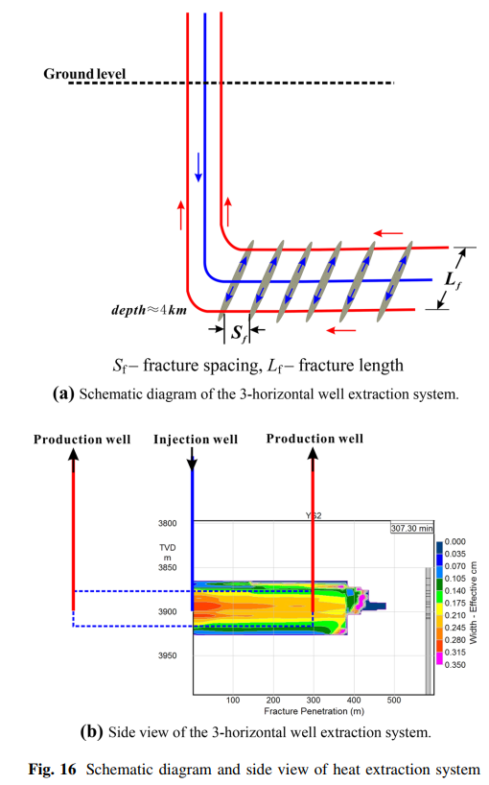
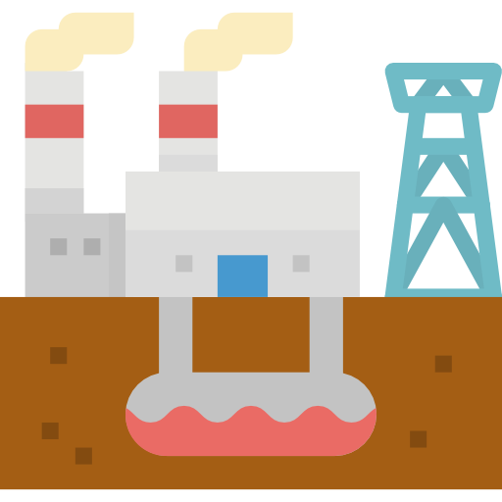
Reservoir Stimulation
Injection and production wells
Horizontal wells
Symmetrical fractures
One injection well and two production wells
Schematic diagram and side view of heat extraction well
(Guo et al., 2016)
Notes:
Reservoir layers are assumed to be horizontally oriented.
Fractures are symmetrical around the wellbore.
Three-horizontal well EGS in the reservoir is proposed for heat extraction:
One injection well flanked by two production wells drilled parallel to the minimum horizontal stress.

Slide 7
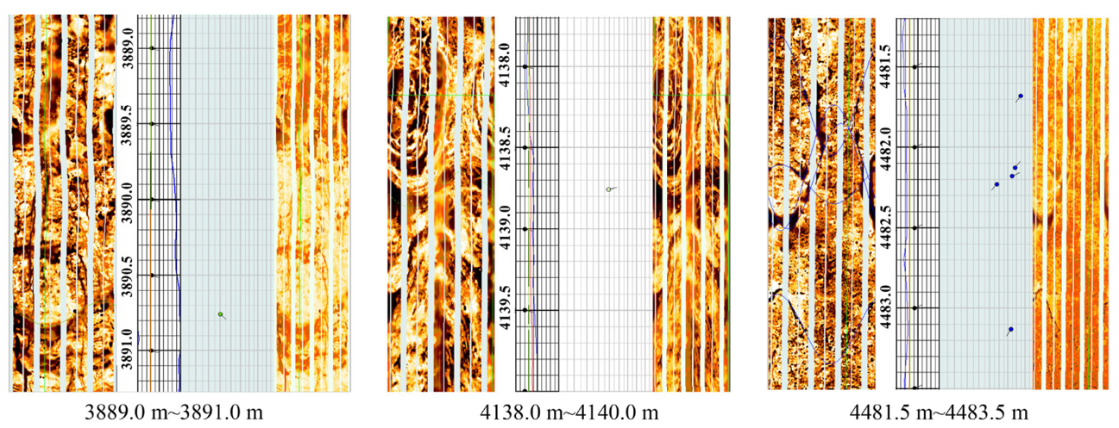
Operation of Reservoir
1. Rock-Fluid Interactions:
Cold Water injection (10degree)
Natural Rock Formation
(140degree-188degree)
Heated Water
Slow Cooling of the rocks over time
Heat Transfer Dynamics:
c) Fracture Analysis and Impact:
(Guo et al., 2016)
b) Geochemical Effects:
Mineral Scaling and Dissolution
Formation micro scanner images of the target formation in YS-2
(Guo et al., 2016)
(Guo et al., 2016)
Notes:
The other Figure (Formation Micro Scanner Images): Essential for analyzing the physical structure of the target formation, supporting strategies for hydraulic stimulation.
Heat Transfer Process: Upon contact, heat is transferred from the hotter rock to the cooler injected water predominantly through conduction along the solid rock matrix and convection within the fluid-filled fractures. This dynamic interaction enhances the overall thermal recovery but also cools the rock matrix over time, potentially reducing reservoir efficacy.
Geochemical Stability and Reactions:The change in temperature due to the interaction of cold water and hot rock can lead to thermal stresses that alter the geochemical stability of the rock. This includes the dissolution of minerals which can increase reservoir permeability or the formation of scale which might block fluid pathways. As the fluid interacts with the formation, any change in mineral composition or physical structure due to these interactions can affect the fluid dynamics. For instance, the dissolution of calcite or precipitation of silica within fracture spaces can modify the porosity and permeability of the reservoir rocks.
Natural Fracture States: Formation micro scanner images provide insight into the pre-existing natural fractures and rock integrity.

Slide 8
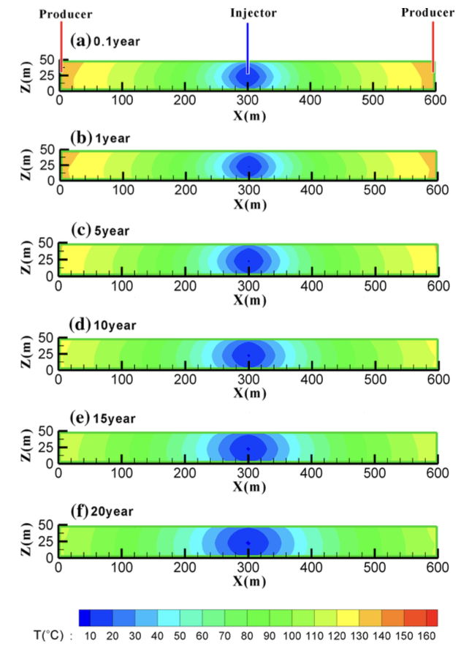
Operation of Reservoir
2. Efficiency of the System:
Operational Temperatures and Energy Recovery
b) Recovery Efficiency
c) Performance Metrics
Water Input
10°C to maximize thermal gradient
Water Output
Decreases from 135°C to 111°C over 20 years
Recovery Percentage of 65%
Based on the amount of injected fluid that is successfully extracted from the reservoir
Initial vs. Long-term Output
Demonstrates a decline in heat output, impacting long-term sustainability
Evolution of temperature distribution on fracture plane over 20-year period
(Guo et al., 2016)
(Guo et al., 2016)
Notes:
- Figure 22 (Temperature Distribution on Fracture Plane): Visualizes the temperature drop within the reservoir, crucial for assessing thermal recovery rates and system efficiency.

Slide 9
References
Guo, L., Zhang, Y., Yu, Z., Hu, Z., Chengyu, L., & Xu, T. (2016). Hot dry rock geothermal potential of the Xujiaweizi area in Songliao Basin, northeastern China. Environmental Earth Sciences, 75(6). https://doi.org/10.1007/s12665-016-5327-9
Huang, X., Zhu, J., Niu, C., Li, J., Hu, X., & Jin, X. (2014, October). Heat extraction and power production forecast of a prospective Enhanced Geothermal System site in Songliao Basin, China. Energy, 75, 360–370. https://doi.org/10.1016/j.energy.2014.07.085
Advantages
Reduced drilling costs
Abundant water resources
Reduced impact of earthquakes

Slide 10

Thank you for
your attention!

